Slide 1
CONTENTS
Overview of Quality Standards
SEI-CMM
ISO 9001

Slide 2
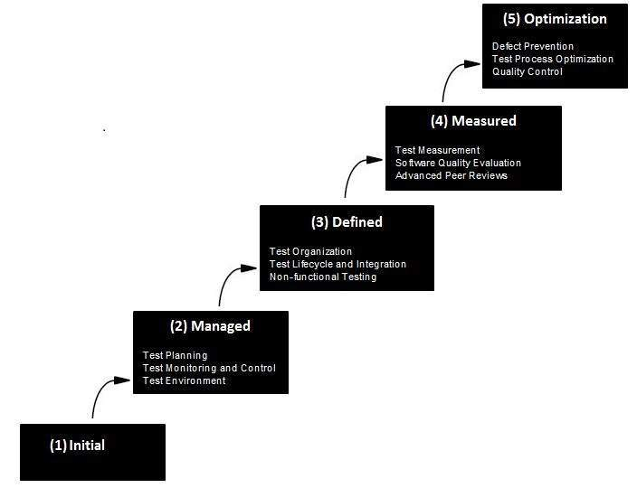
What is Capability Maturity Model?
The Software Engineering Institute (SEI) Capability Maturity Model (CMM) specifies an increasing series of levels of a software development organization. The higher the level, the better the software development process, hence reaching each level is an expensive and time-consuming process.

Slide 3
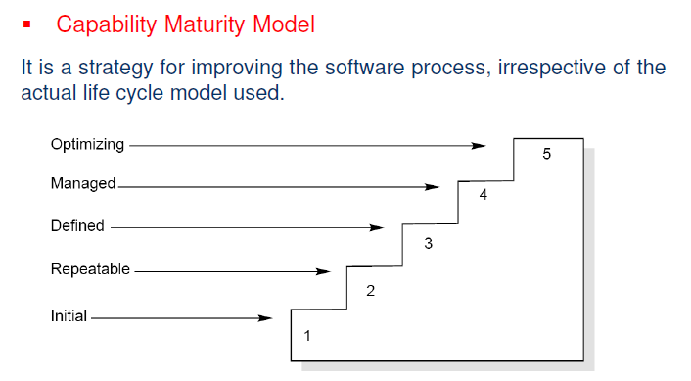
Figure: Maturity levels of CMM

Slide 4
Maturity Levels:
Initial (Maturity Level 1)
Repeatable (Maturity Level 2)
Defined (Maturity Level 3)
Managed (Maturity Level 4)
Optimizing (Maturity Level 5)

Slide 5
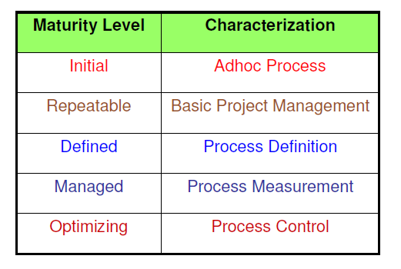
Figure: The five levels of CMM

Slide 6
Key Process Area (KPA)
A process area (PA) contains the goals that must be reached in order to improve a software process. A PA is said to be satisfied when procedures are in place to reach the corresponding goals. A software organization has achieved a specific maturity level once all the corresponding PAs are satisfied. The process areas (PA’s) have the following features:
Identify a cluster of related activities that, when performed collectively, achieve a set of goals considered important for enhancing process capability.
Defined to reside at a single maturity level.
Identify the issues that must be addressed to achieve a maturity level.

Slide 7
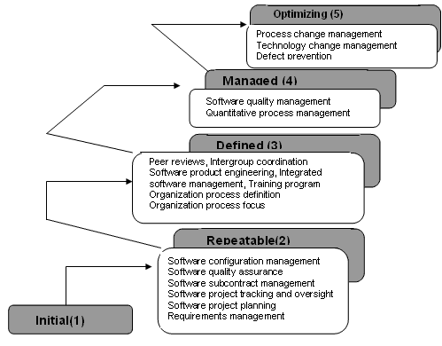

Slide 8
The different maturity levels have different process areas pre-defined as shown in the figure above. The SEI CMMI Level 5 has 3 PA’s defined:
Process change management: To identify the causes of defects and prevent them from recurring.
Technology change management: To identify beneficial new technology and transfer them in an orderly manner
Defect prevention: To continually improve the process to improve quality, increase productivity, and decrease development time.

Slide 9
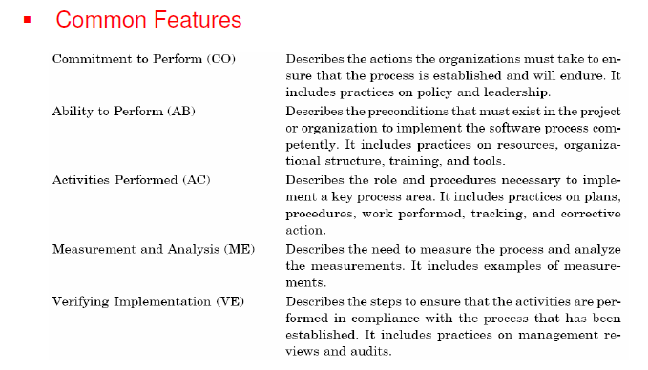

Slide 10
International Organization for Standardization
ISO certification certifies that a management system, manufacturing process, service, or documentation procedure has all the requirements for standardization and quality assurance. ISO (International Organization for Standardization) is an independent, non-governmental, international organization that develops standards to ensure the quality, safety, and efficiency of products, services, and systems.
ISO certifications exist in many areas of industry, from energy management and social responsibility to medical devices and energy management. ISO standards are in place to ensure consistency. Each certification has separate standards and criteria and is classified numerically. For instance, the ISO certification we currently hold at Mead Metals is ISO 9001:2015

Slide 11
ISO 9001 Definition
The certification ISO 9001:2008 includes three components: ISO, 9001, and 2015. Here's what each component represents:
ISO
As mentioned above, ISO refers to the International Organization for Standardization. This organization develops the standards, and it does in order to certify businesses or organizations. Certification is handled third-party and tested annually.
9001
The number appearing after ISO classifies the standard. All standards within the ISO 9000 family refer to quality management. ISO 9001 is among ISO's best-known standards, and it defines the criteria for meeting a number of quality management principles. It helps businesses and organizations be more efficient and improve customer satisfaction.
2015
The final number in an ISO certification refers to the version of the standard that's being met and is represented by the calendar year those standards were launched. 2015 is the fifth edition of ISO 9001. It was launched in September 2015, and Mead Metals has updated its processes to meet the specifications of this newest version.

Slide 12
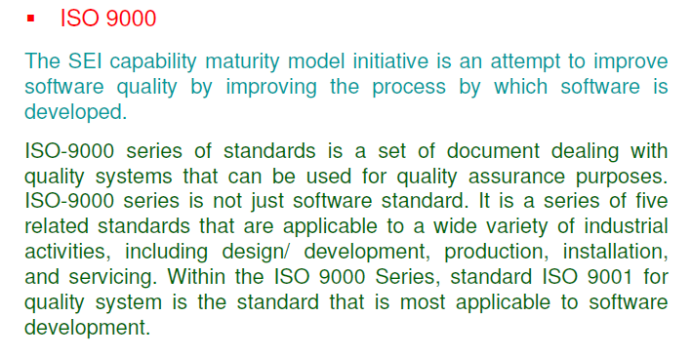

Slide 13
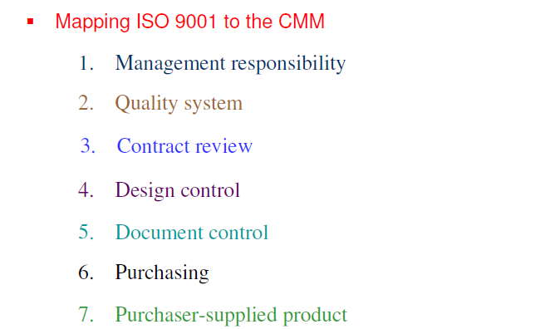

Slide 14
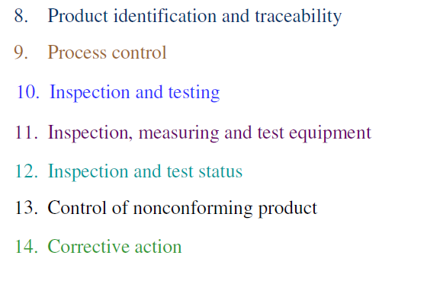

Slide 15
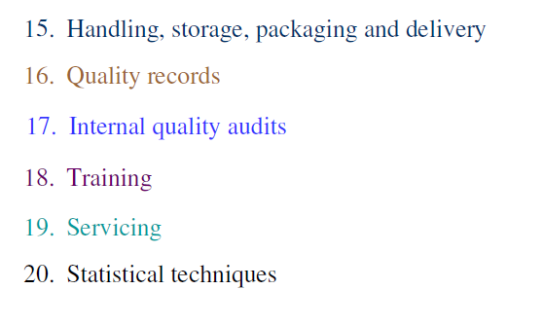

Slide 16
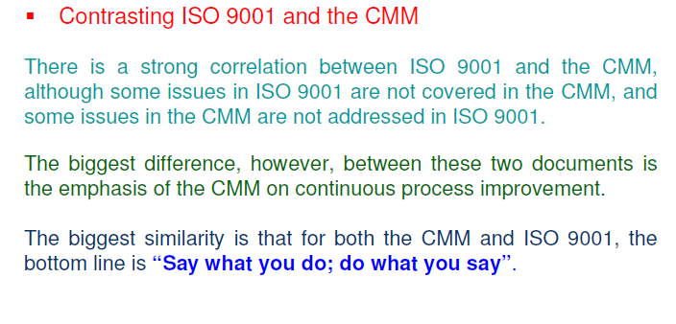

Slide 17
QUESTIONS
Q-1. CMM level 1 has
6 KPAs
3 KPAs
(c) 0 KPAs
(d) None of the above
Q-2. CMM model is a technique to
Improve the software process
Automatically develop the software
(c) Test the software
(d) All of the above

Slide 18
Q-3. Total number of maturing levels in CMM are
1
3
(c) 5
(d) 7
Q-4. CMM stands for
Capacity maturity model
Capability maturity model
(c) Cost management model
(d) Comprehensive maintenance model

Slide 19
Q-5. The number of clauses used in ISO 9001 are
15
25
(c) 20
(d) 10

Slide 20
THANK YOU

